Slide 1

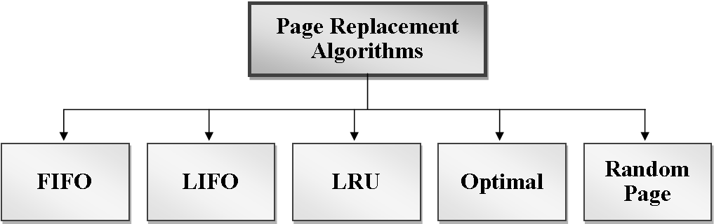
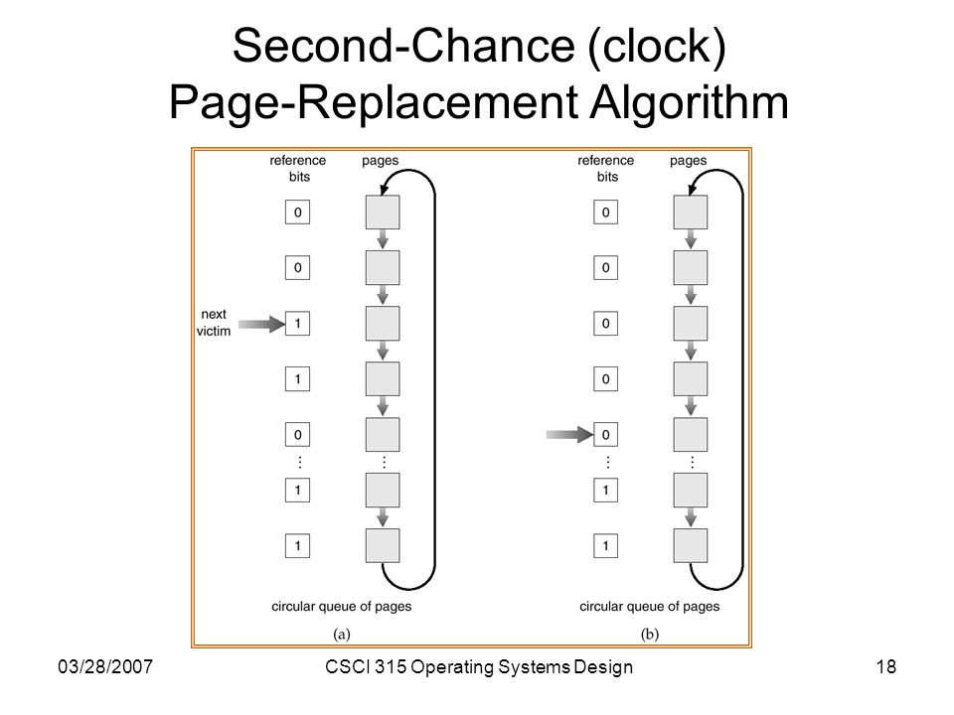
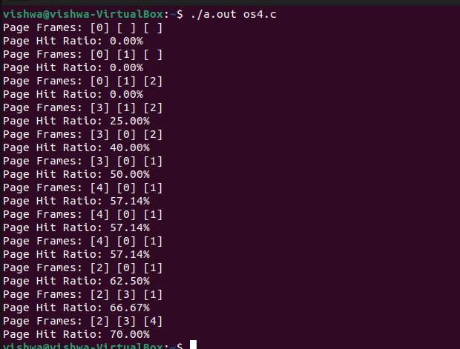
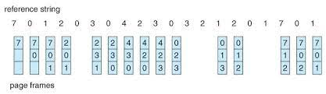
RV College of Engineering
Go, change the world
IMPLENETATION FIFO USING SECONDPAGE REPLACEMENT
^{Name:} SHIVARAJ CHAWAN(1RV22CS185)
^{VISHWANATH A D(1RV22CS234)}
Introduction to Paging :
The process of retrieving processes in the form of pages from the secondary storage into the main memory is known as paging.
Basic terms used in paging are page offset, paging table,logical address space, physical address space,frame size.
These are some advantages of using paging:
1.Paging allows for efficient use of physical memory by dividing it into fixed-size blocks (page frames) and virtual memory into corresponding pages.
2.The operating system can easily allocate and deallocate memory pages without the need for contiguous physical memory blocks.
3.Unlike some memory allocation strategies, such as contiguous memory allocation, paging eliminates external fragmentation.
SECOND CHANCE REPLACEMENT(CLOCK)
Here's how the Second-Chance paging policy works:
1.Page Frame Queue:
Maintain a circular queue (a data structure) that represents the order in which pages are brought into memory. Each page in the queue has an additional reference bit associated with it.
2.Reference Bit:
Introduce a reference bit for each page in the page frame set. The reference bit is initially set to 0.
3.Page Fault Occurs:
When a page fault occurs (i.e., a program attempts to access a page not currently in physical memory), the operating system examines the page at the front of the queue.
4.Check Reference Bit:
If the reference bit of the page at the front is 0, it is a candidate for replacement. The page is replaced, and the new page is added to the rear of the queue.
5.If Reference Bit is 1 (Second Chance):
If the reference bit is 1, indicating that the page has been referenced recently, the page is given a "second chance." The reference bit is cleared (set to 0), and the page is moved to the rear of the queue. The algorithm then checks the next page in the queue.
6.Repeat:
Steps 3-5 are repeated until a suitable page for replacement is found.
FIFO(FIRST IN FIRST OUT)
FIFO, which stands for First-In-First-Out, is a simple and straightforward page replacement algorithm used in operating systems. It operates on the principle of replacing the oldest page in memory when a page fault occurs. Here's how FIFO page replacement works:
1.In these we need to know how many frames is assigned and now we should go the reference
String which consist set of pages of processes should be added in the frames.
2.Firstly we added the pages until all the frames in the main memory and all of them considered as page fault i.e all the pages of processes are brought from secondary memory which will take more time.
3,Then if the page coming is same as the page present in the first frame then no changes is done and it considered as page hit and next page is compared with same frame page and repeats for all the pages which are present in the list.
.
4.0therwise it considered as pagefault and page present in first frame is replaced by new page
and next page in the set is compared to page present in the second frame if same its
considered as page hit otherwise page fault and replaced .
5. Next each pages are compared to increment of the previous frame pages if they are same considered as page hit and new page is compared to same page frame and if its not same its known as page fault and replaced by new page.
Below one is example for FIFO
:
Submitted to: Dr Jyothi shetty
Acknowledgements
The authors thanks Principal and HoD, Department of Computer Science Engineering,

